Slide 1


Big data analytics for MOOC video watching behavior based on Spark
Presented By:
Basmah AlQahtani

Slide 2
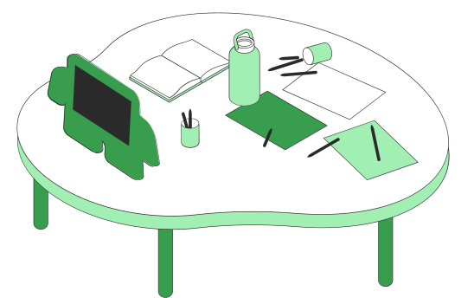
We will discuss
Paper Information
Introduction
Methods
Data analysis algorithms
Results and discussion
Conclusions and future work

Slide 3


Icebreaker !

Slide 4


Scan QR …

Slide 5

About this paper …
Big data analytics for MOOC video watching behavior based on Spark
Wanlin Gao
Minjuan Wang
Hui Hu
Guofeng Zhang
Published by: 7 January 2019
Article Accesses: 912
Web of Science: 11
CrossRef: 12

Slide 6
Abbreviations …
01
MOOC = Massive Open Online Courses.
LVW = The Length of the Video Watched.
RDD = The Resilient Distributed Dataset.
JSON = JavaScript Object Notation.
HDFS = Hadoop Distributed File System.
Introduction

Slide 7
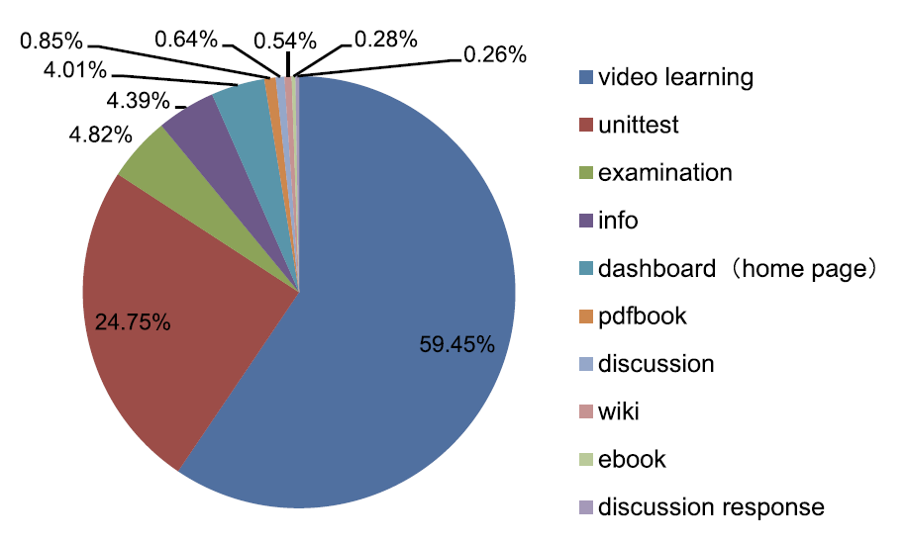
The Purpose …
01
measure the effectiveness of courses delivered using MOOCs at China Agricultural University.
Introduction

Slide 8
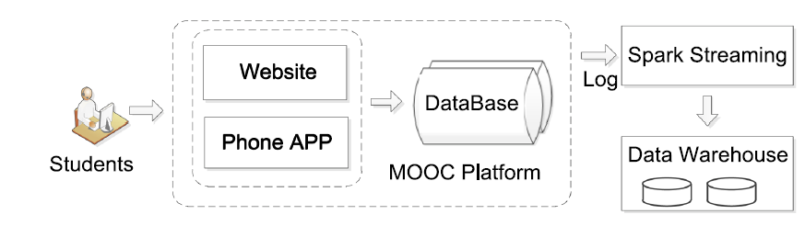
The proposed structure for big data analysis framework in MOOC
02
Methods

Slide 9
02
Methods …
Data collection
Data preprocessing
Data analysis algorithms
The cauX dataset has 29,059,818 log
data and contains 11 attributes
Computational tools—Spark
Standardize data
Feature selection
Error analysis and processing
The time distribution characteristics
Video length distribution characteristics
Entropy weight method

Slide 10
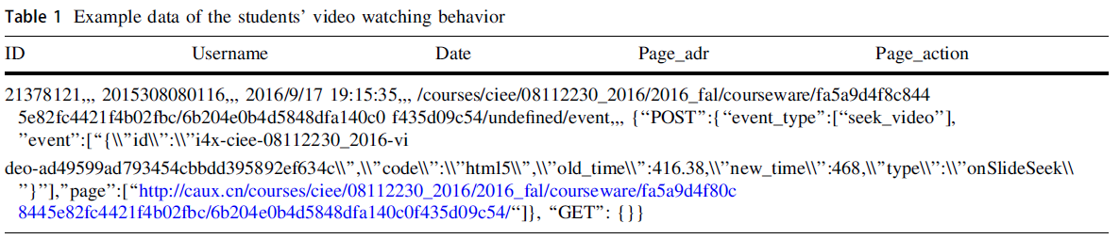
Data collection …
association rule analysis only selects students’ video watching data of the course named computer graphics set up in 2016 as a case study.
page action includes hide transcript, load video, play video, pause the video, speed change, sequence video, seek video and page close,
02
Methods

Slide 11
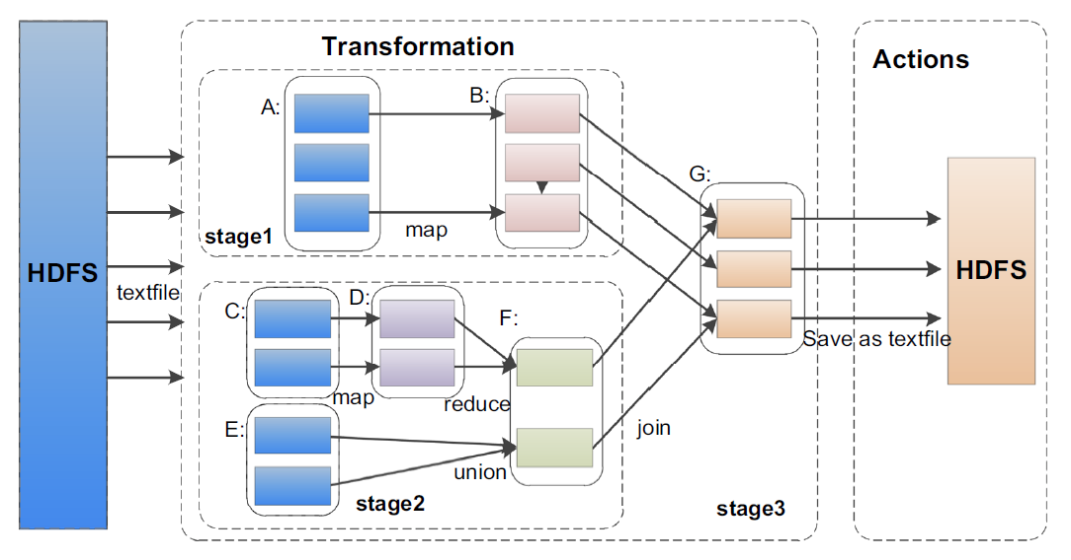
Data Preprocessing …
Computational tool _ Spark
The architectural foundation of Spark
02
Methods

Slide 12
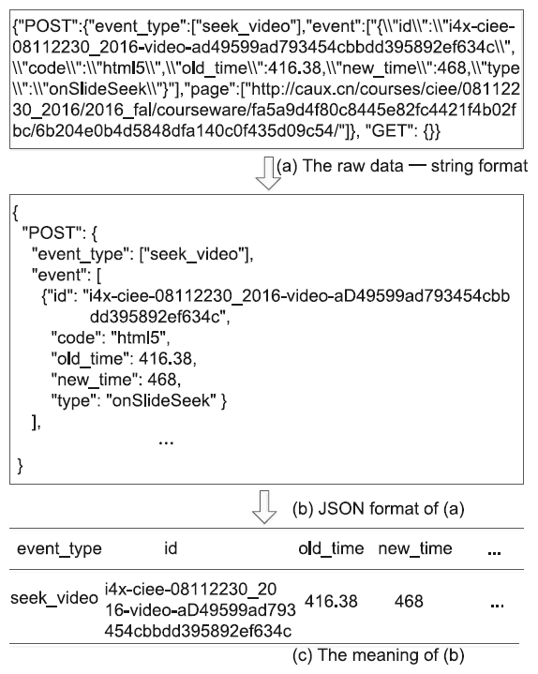
Data Preprocessing …
2. Standardize data
02
Methods

Slide 13
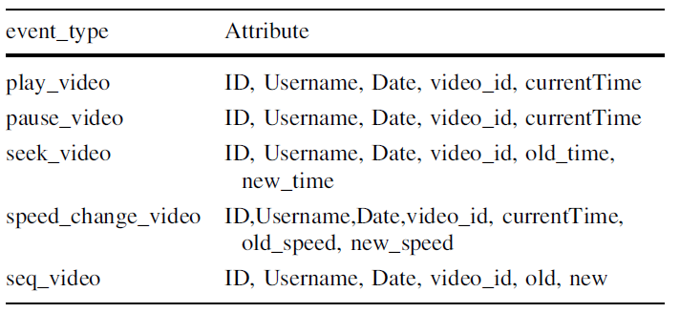
Data Preprocessing …
3. Features selection
Focus on the video watching behaviors of play, pause, seek, speed change, sequences video.
02
Methods

Slide 14
Data Preprocessing …
4. Error analysis and processing
The log model will record information when the students click the speed change button, although the speed the students choose is the same as before.
For the continuous seek video, the changes in every second are recorded and obtained by the log model. Therefore, we only take the first old-time and the last new time to analyze this preprocessing of continuous behavior.
02
Methods

Slide 15


Data analysis algorithms
The time distribution characteristics of students’ video watching
Video length distribution characteristics of students’ video watching
Entropy weight method

Slide 16
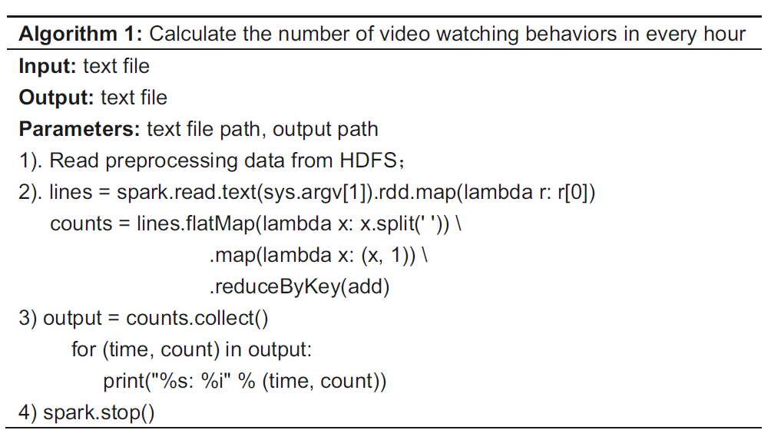
The time distribution characteristics of students’ video watching
03
Data analysis algorithms

Slide 17
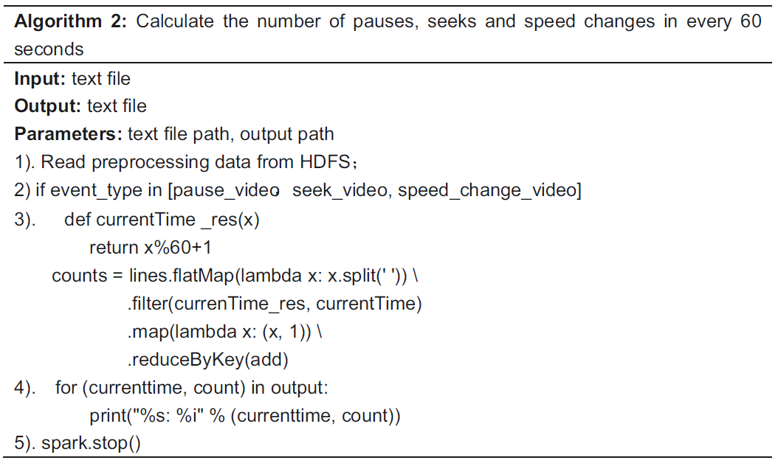
The video length distribution characteristics of students’ video watching
03
Data analysis algorithms

Slide 18
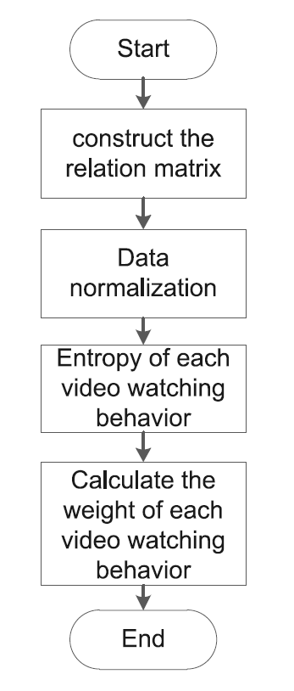
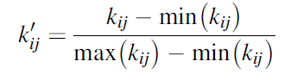
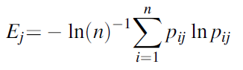
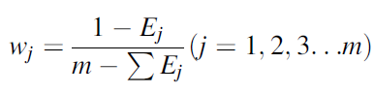
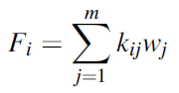
Entropy weight method
03
Data analysis algorithms

Slide 19
04
Results & Discussion

Slide 20
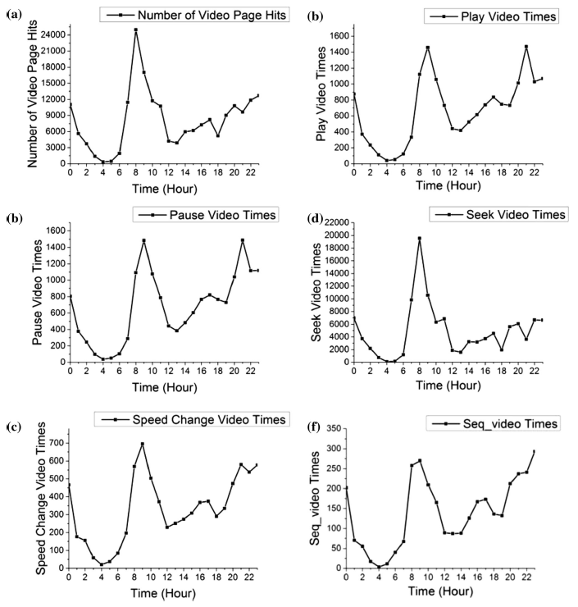
Results & Discussion

Slide 21
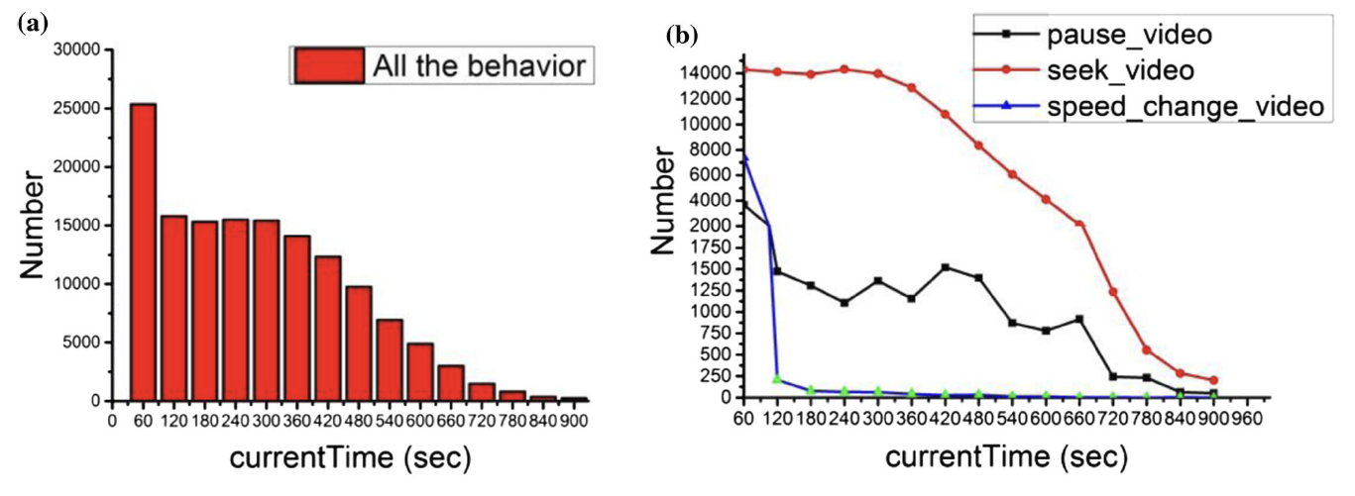
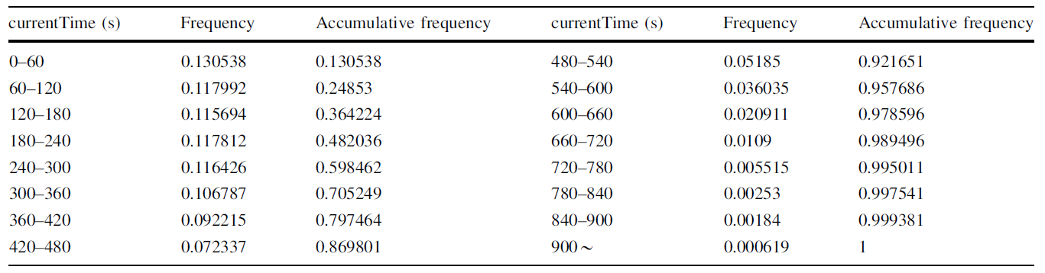
Results & Discussion

Slide 22

05
Conclusion and future work

Slide 23
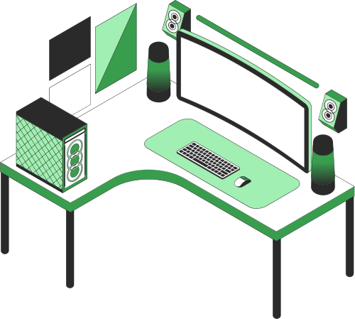
Do you have any questions?

